Slide 1
Unit-IV
COMPUTER CMMUNICATION

Slide 2
Syllabus
Framing, Flow Control Mechanisms
Stop Wait Protocol
Goback N ARQ, Selective Reject ARQ
CRC, Checksum
Types of Errors
Error Correction
CSMA, CSMA/CD
HDLC
PPP

Slide 3
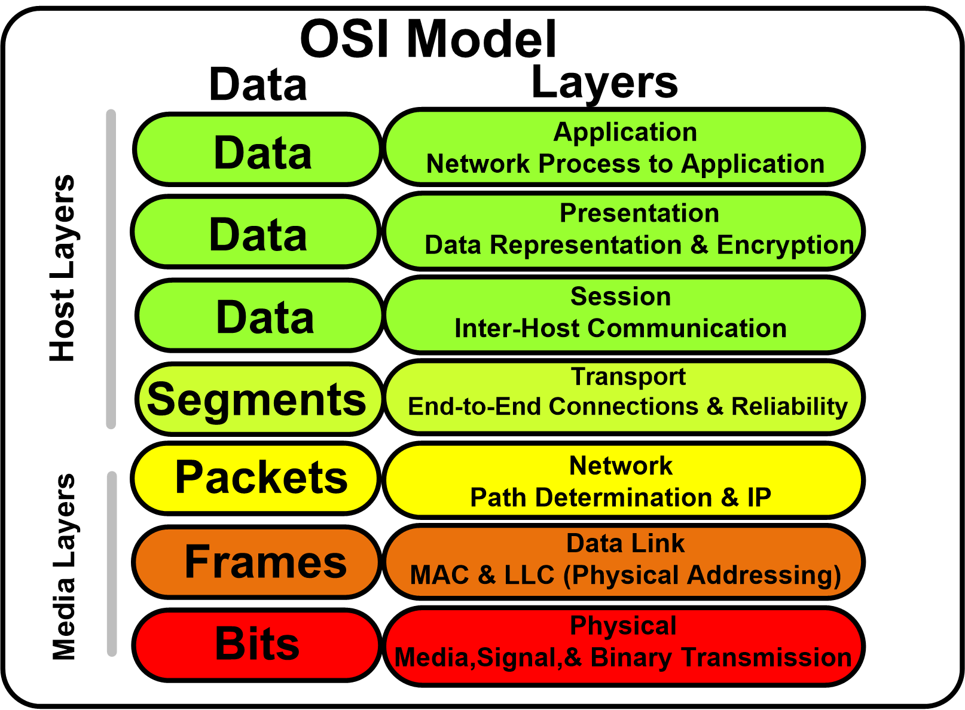

Slide 4

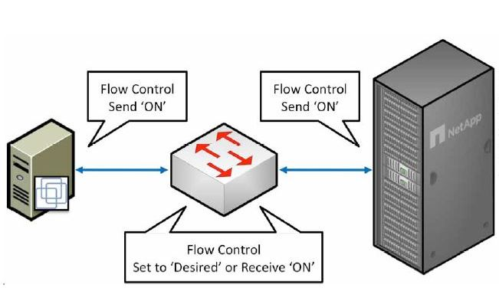
Functions of the Data-link layer
Framing:
The data link layer translates the physical's raw bit stream into packets known as Frames.
The Data link layer adds the header and trailer to the frame.
The header which is added to the frame contains the hardware destination and source address.
Physical Addressing:
The Data link layer adds a header to the frame that contains a destination address.
The frame is transmitted to the destination address mentioned in the header.
Flow Control:
Flow control is the main functionality of the Data-link layer.
It is the technique through which the constant data rate is maintained on both the sides so that no data get corrupted.
It ensures that the transmitting station such as a server with higher processing speed does not exceed the receiving station, with lower processing speed.

Slide 5
Functions of the Data-link layer
Error Control:
Error control is achieved by adding a calculated value CRC (Cyclic Redundancy Check) that is placed to the Data link layer's trailer which is added to the message frame before it is sent to the physical layer.
If any error seems to occur, then the receiver sends the acknowledgment for the retransmission of the corrupted frames.
Access Control:
When two or more devices are connected to the same communication channel, then the data link layer protocols are used to determine which device has control over the link at a given time.

Slide 6
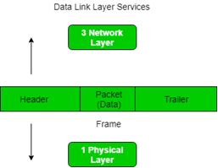
Framing
What is Framing?
Framing is a point-to-point connection between two computers or devices consists of a wire in which data is transmitted as a stream of bits.
Framing is a function of the data link layer.
It provides a way for a sender to transmit a set of bits that are meaningful to the receiver.
Frames have headers that contain information such as error-checking codes.
At data link layer, it extracts message from sender and provide it to receiver by providing sender’s and receiver’s address.
The advantage of using frames is that data is broken up into recoverable chunks that can easily be checked for corruption.

Slide 7
Problems in Framing
Detecting start of the frame:
When a frame is transmitted, every station must be able to detect it. Station detect frames by looking out for special sequence of bits that marks the beginning of the frame i.e. SFD (Starting Frame Delimiter).
How do station detect a frame:
Every station listen to link for SFD pattern through a sequential circuit. If SFD is detected, sequential circuit alerts station. Station checks destination address to accept or reject frame.
Detecting end of frame:
When to stop reading the frame.

Slide 8
Types of framing
There are two types of framing:
1. Fixed size – The frame is of fixed size and there is no need to provide boundaries to the frame, length of the frame itself acts as delimiter.
Drawback: It suffers from internal fragmentation if data size is less than frame size
Solution: Packaging
2. Variable size – In this ,there is need to define end of frame as well as beginning of next frame to differentiate.
This can be done in two ways:
Length field – We can introduce a length field in the frame to indicate the length of the frame. Used in Ethernet(802.3). The problem with this is that sometimes the length field might get corrupted.
End Delimiter (ED) – We can introduce an ED(pattern) to indicate the end of the frame. Used in Token Ring. The problem with this is that ED can occur in the data, this can be resolved by two types.

Slide 9
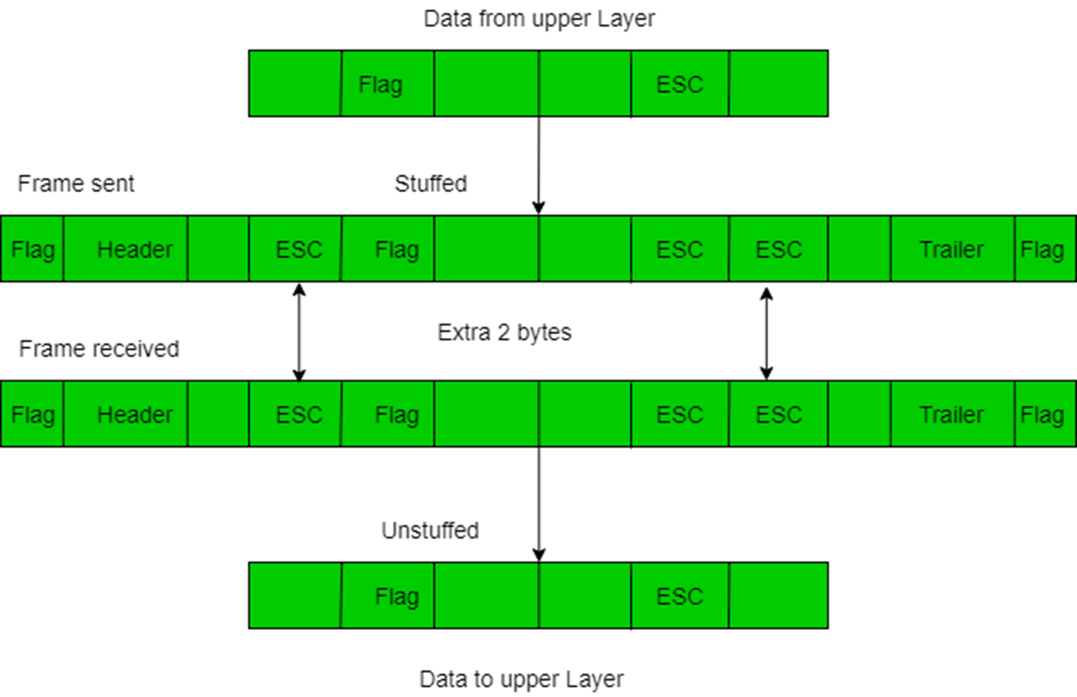
This can be solved by
1. Character/Byte Stuffing: Used when frames consist of character. If data contains ED then, byte is stuffed into data to diffentiate it from ED.
Let ED = “$” –> if data contains ‘$’ anywhere, it can be escaped using ‘O’ character. –> if data contains ‘O$’ then, use ‘OOO$'($ is escaped using O and O is escaped using O).
Disadvantage – It is very costly and outdated method

Slide 10
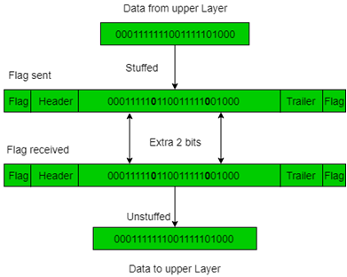
2. Bit Stuffing: Let ED = 01111 and if data = 01111 –> Sender stuffs a bit to break the pattern i.e. here appends a 0 in data = 011101. –> Receiver receives the frame. –> If data contains 011101, receiver removes the 0 and reads the data.

Slide 11
Examples –
If Data –> 011100011110 and ED –> 01111 then, find data after bit stuffing ?
–> 01110000111010
If Data –> 110001001 and ED –> 1000 then, find data after bit stuffing ?
–> 11001010011

Slide 12
Flow control
If the rate at which the data are absorbed by the receiver is less than the rate at which data are produced in the sender, the data link layer imposes a flow control mechanism to avoid overwhelming the receiver.
Flow control is the main functionality of the Data-link layer.
It is the technique through which the constant data rate is maintained on both the sides so that no data get corrupted.
It ensures that the transmitting station such as a server with higher processing speed does not exceed the receiving station, with lower processing speed.
If sender is sending too fast the receiver may be overloaded, (swamped) and data may be lost.

Slide 13
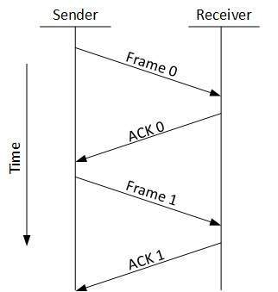
Two types of mechanisms can be deployed to control the flow:
1.Stop and Wait
2.Error Control
Stop and Wait
This flow control mechanism forces the sender after transmitting a data frame to stop and wait until the acknowledgement of the data-frame sent is received.

Slide 14
Error control
Error control is achieved by adding a calculated value CRC (Cyclic Redundancy Check) that is placed to the Data link layer's trailer which is added to the message frame before it is sent to the physical layer.
If any error seems to occur, then the receiver sends the acknowledgment for the retransmission of the corrupted frames.
The data link layer adds reliability to the physical layer by adding mechanisms to detect and retransmit damaged or lost frames.
It also uses a mechanism to recognize duplicate frames.
Error control is normally achieved through a trailer added to the end of the frame.

Slide 15
Requirements for error control mechanism:
Error detection - The sender and receiver, either both or any, must discover that there is some error in the transit.
Positive ACK - When the receiver receives a correct frame, it should acknowledge it.
Negative ACK - When the receiver receives a damaged frame or a duplicate frame, it sends a NACK back to the sender and the sender must retransmit the correct frame.
Retransmission: The sender maintains a clock and sets a timeout period. If an acknowledgement of a data-frame previously transmitted does not arrive before the timeout the sender retransmits the frame, thinking that the frame or it’s acknowledgement is lost in transit.
There are three types of techniques available which Data-link layer may deploy to control the errors by Automatic Repeat Requests (ARQ):

Slide 16
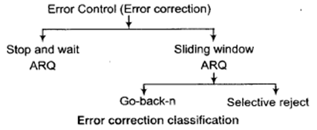

Slide 17
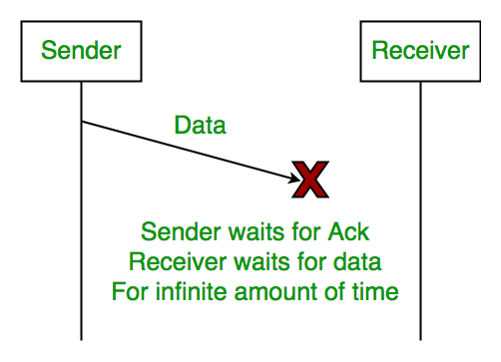
Problem 1

Slide 18
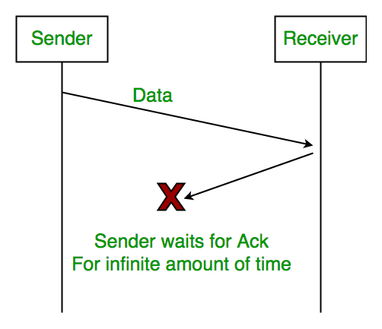
Problem 2 (Lost Acknowledgement)
Problem 3( Delayed Acknowledgement/Data):
After timeout on sender side, a long delayed acknowledgement might be wrongly considered as acknowledgement of some other recent packet.

Slide 19
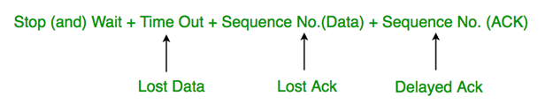
Stop and Wait ARQ
(Automatic Repeat Request)
Above 3 problems are resolved by Stop and Wait ARQ (Automatic Repeat Request) that does both error control and flow control.

Slide 20
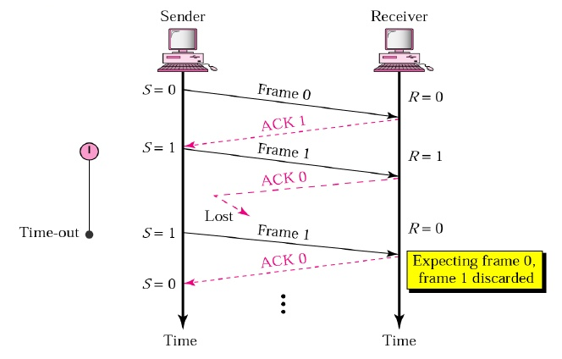
Lost data/frame

Slide 21
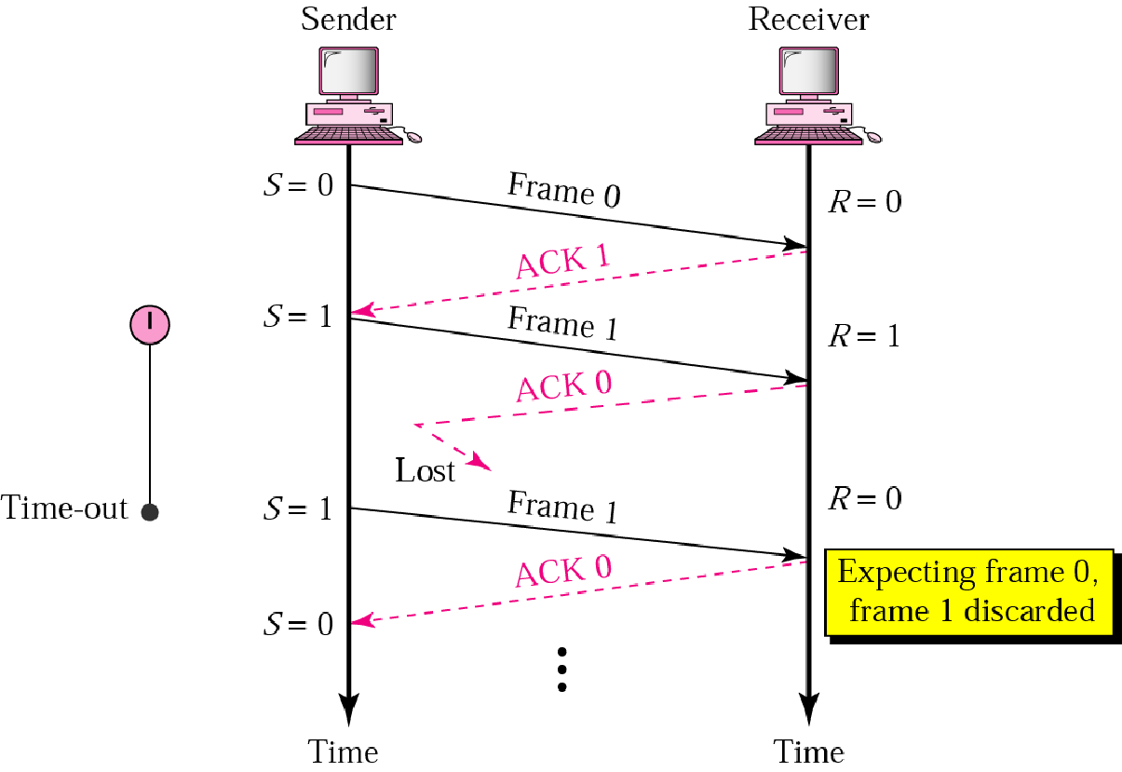
ARQ Lost Acknowledgement
3. Delayed Acknowledgement: This is resolved by introducing sequence number for acknowledgement also.

Slide 22
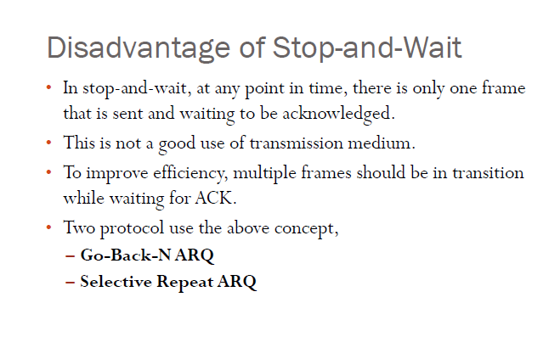

Slide 23
Sliding Window Protocol
Sliding Window Protocol is actually a theoretical concept in which we have only talked about what should be the sender window size (1+2a) in order to increase the efficiency of stop and wait ARQ.
Now we will talk about the practical implementations in which we take care of what should be the size of receiver window.
Practically it is implemented in two protocols namely :
Go Back N (GBN)
Selective Repeat (SR)
In this article, we will explain you about the first protocol which is GBN in terms of three main characteristic features and in the next part we will be discussing SR as well as comparison of both these protocols

Slide 24
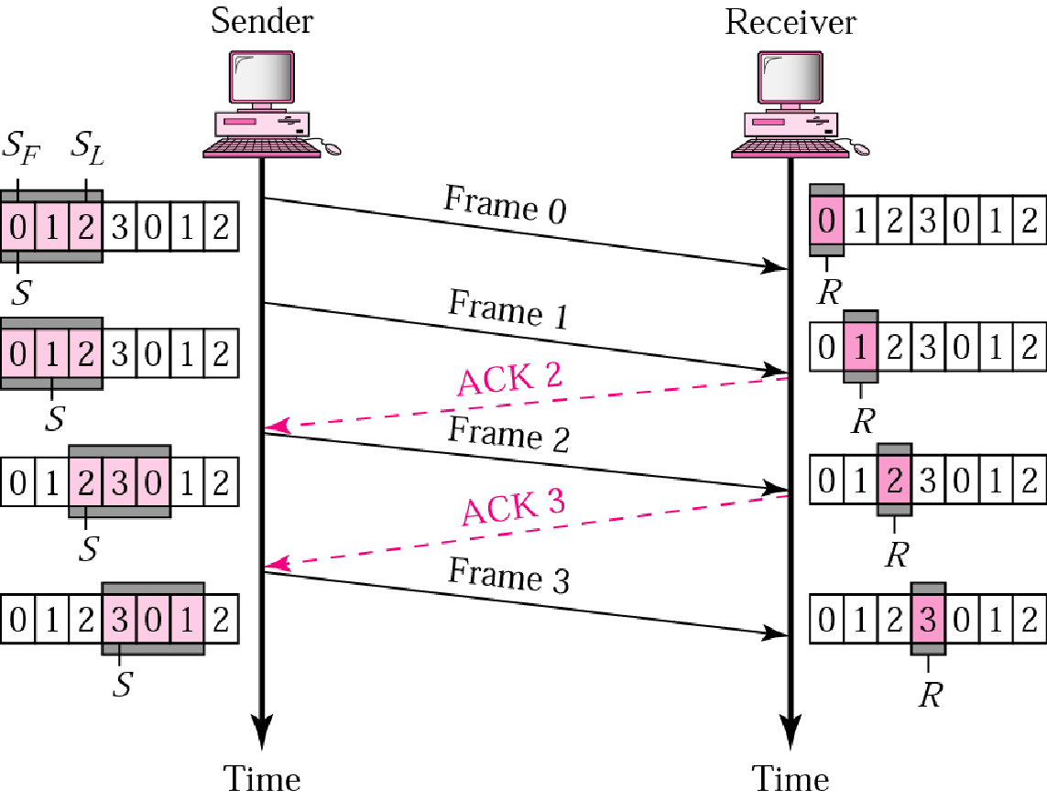
Go Back N ARQ
In Go-back-n ARQ, if a frame is lost or damaged all frames sent since last frame acknowledged are retransmitted
Similarly if an acknowledgment is lost, sliding window waits for the acknowledgement for some specified time. If acknowledgement does not arrive within the time, the data is retransmitted again

Slide 25
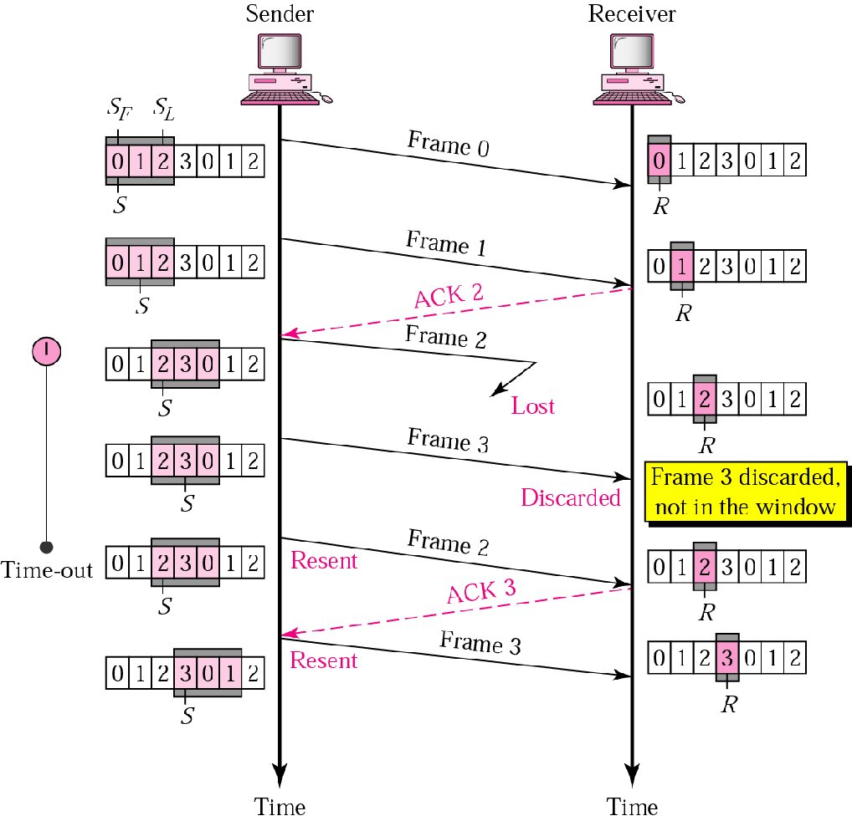
Go-back-n: Damaged Frame

Slide 26
We can see that six frames Frame 0,1,2,3,4,5 are being transmitted before an error is discovered in frame 3.
An ACK3 has been returned by receiver showing that frames 0,1,2 have been received undamaged. The ACK3 has been sent before data 3 has arrived
Data 3 is found to be damaged and so NAK3 has been sent immediately and frames 4 and 5 are discarded
Sending device now retransmits all frames 3,4,5 sent since last acknowledgement and process continues
Receiver discards frames 4 and 5 till it receive data 3 undamaged.

Slide 27
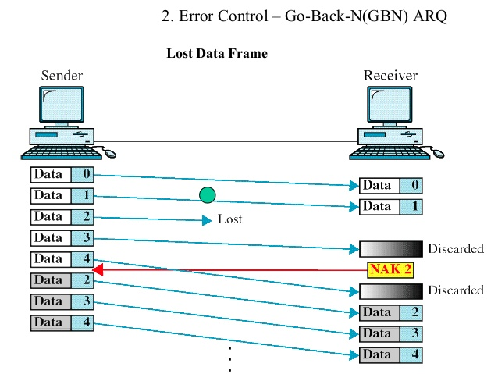
Go-back-n: Lost Data Frame

Slide 28
In this send five data frames 0 through 4 are transfered.
Two data frames data 0 and data 1 arrive intact but data 2 is lost
Next frame expected at the receiver is data 3.
Receiver is now expecting data 2 and so considers data3 to be an error and sends an NAK 2 indicating that 0 and 1 have been accepted but 2 is lost.
Data 4 is transmitted before receiving NAK2 which is out of sequence and is therefore discarded.
Once NAK2 is received, sender now retransmits 2,3,4.

Slide 29
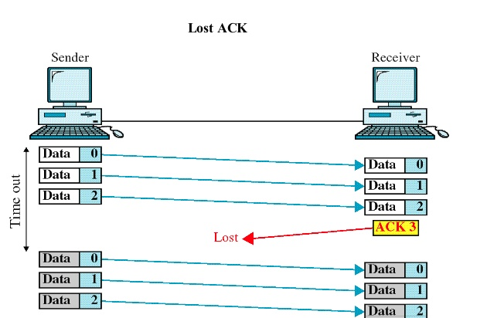
Go-back-n: Lost Acknowledgement

Slide 30
In here the sender have transmitted first three frames 0 through 2.
An acknowledgment ACK3 is now being sent to the sender saying three data frames have been received.
The sender now waits a predetermined amount of time for an acknowledgment of three frames sent.
Once ACK3 is not received within this time, all data frames are retransmitted again.

Slide 31
Selective Reject ARQ
In selective reject ARQ, only specific damaged or lost frame is retransmitted
If a frame is corrupted in transit, NAK is returned and frame is resent out of sequence
Receiving device must be able to sort the frames it has and insert the transmitted frames into proper place in sequence

Slide 32
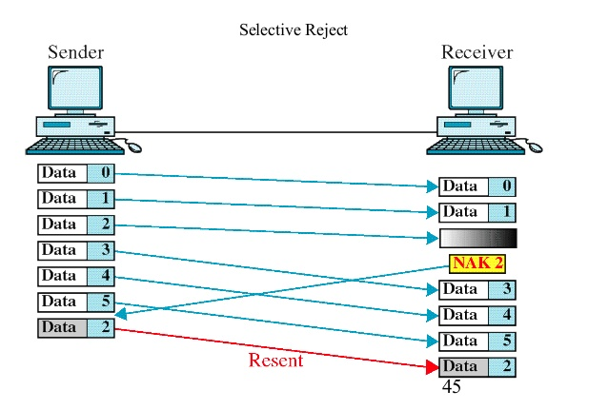

Slide 33
The sender transmits 6 data frames 0 through 5
Once data frames 0 and 1 arrives it is not acknowledged.
Once data 2 is found be damaged, NAK2 is sent which acknowledges that previously unacknowledged data frames that have arrived intact and current data frame is found to be damaged
NAK2 here tells that data 0 and 1 have been accepted and only data 2 has to be resent being damaged unlike go-back-n
Frames received after the damaged frames cannot be acknowledged until the damaged frames have been retransmitted
Receiver accepts data 3,4 5 while waiting for a new copy of data 2.
Once data 2 arrives undamaged, ACK5 can be sent acknowledging new data 2 and original data frames 3,4 and 5.
Logic is needed by the receiver to sort out of sequence transmission and keep track of frames are still missing and which have not yet been acknowledged

Slide 34
Go Back N Vs Selective Reject ARQ
Though retransmitting a specific damaged frame seem to be more efficient than resending all frames
Because of Complexity of storing and sorting required by the receiver and extra logic needed by sender to select specific frames for retransmission, Selective reject ARQ is expensive and not often used
Selective reject ARQ gives better performance but in practice it is usually discarded in favour of go-back-n for simplicity of implementation

Slide 35
Error Detection & Correction

Slide 36
Error Detection & Correction
When an electromagnetic signal flows from one point to another it is subject to interference from heat, magnetism and other forms of electricity
This interference can change the shape of signal
When these signals is carrying binary data, such changes can alter meaning of data resulting in error.
Error when we say can be classified into two types- Single bit and Burst
Single bit error: Error where only one bit of given data unit such as byte, character or packet is changed from 0 to 1.
Burst Error : Error where two or more bits in a given data unit have changed from 1 to 0 or 0 to 1.

Slide 37
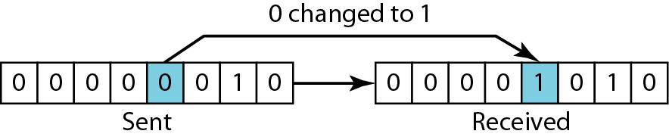
Single Bit Error

Slide 38
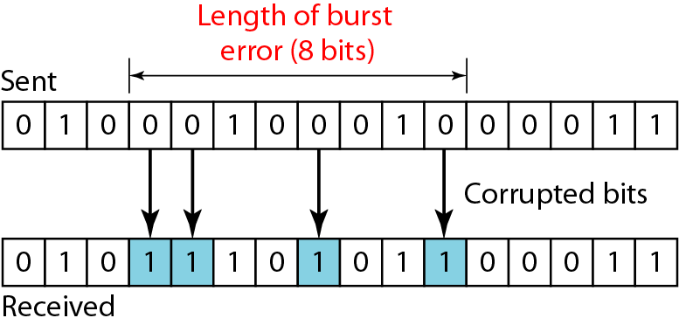
Burst Error

Slide 39
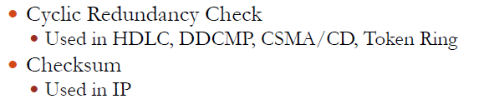
Error Detection Techniques
Once a data is transmitted from sender to receiver, we need to check whether data received is error free or not.
For that we got some Error detection methods that is been used.
Some of them are :
Cyclic Redundancy Check (CRC)
Checksum

Slide 40
Redundancy
Most basic method of error detection is to send every data unit twice
Receiving device would compare both versions of data unit
Any discrepancy would indicate an error and an appropriate correction mechanism could be set in place
This mechanism would be completely accurate but it would be slow.
This would double the transmission time and time it takes to compare bit by bit also must be added.
An improvement of this method is to include EXTRA INFORMATION FOR PURPOSE OF COMPARISON.
This technique is called Redundancy as extra bits are redundant to the information and discarded as soon as the accuracy of information is determined

Slide 41
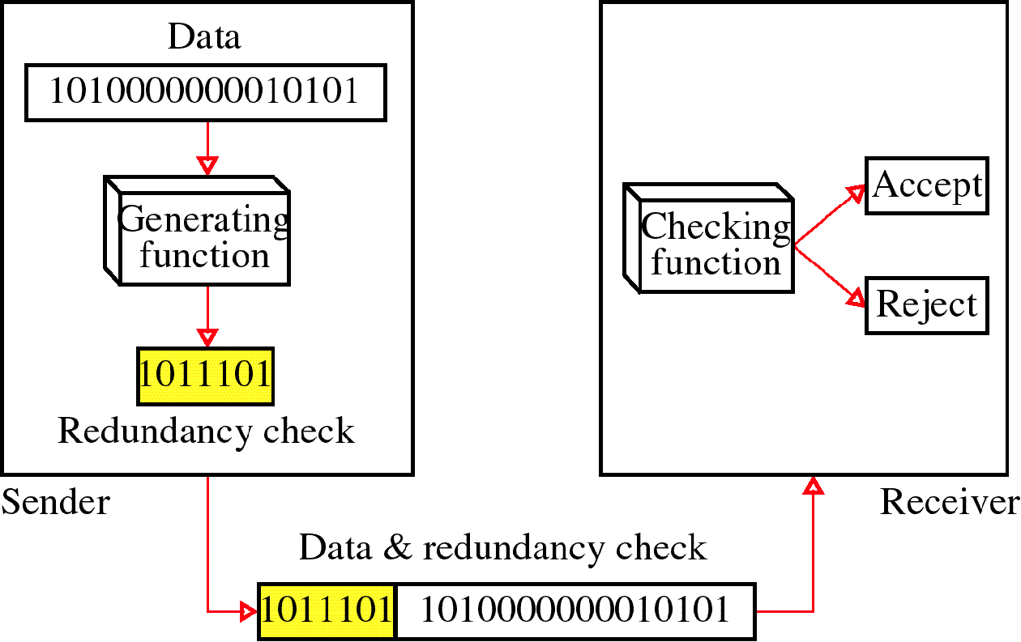

Slide 42
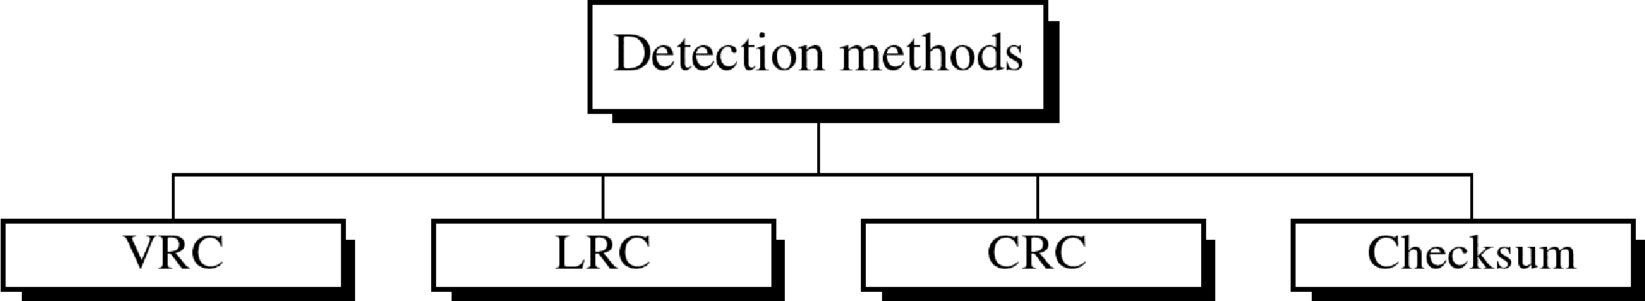
Four types of redundancy checks are used
in data communications

Slide 43
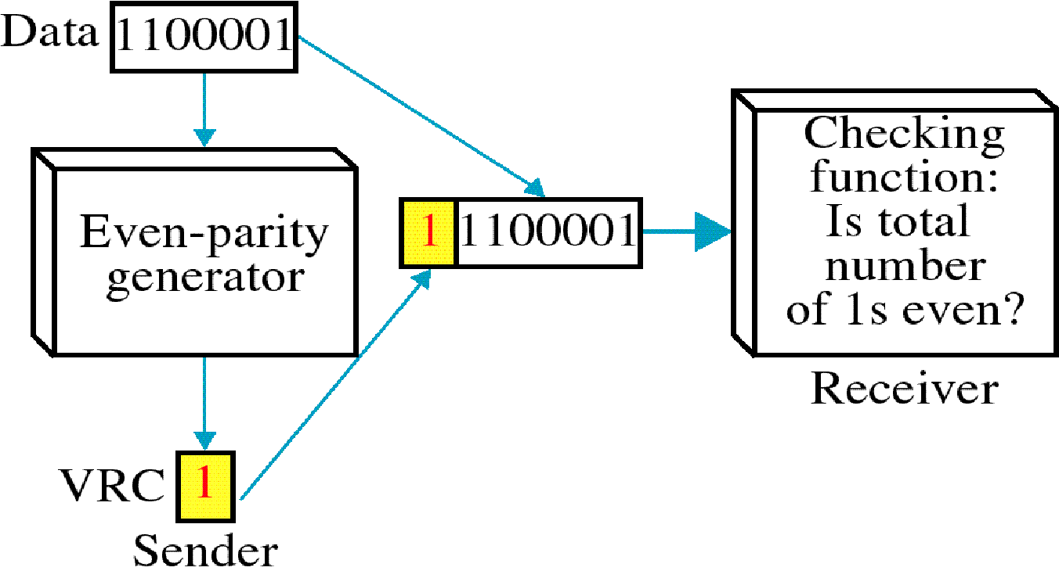
Vertical Redundancy Check - VRC

Slide 44
Performance
It can detect single bit error
It can detect burst errors only if the total number of errors is odd.

Slide 45
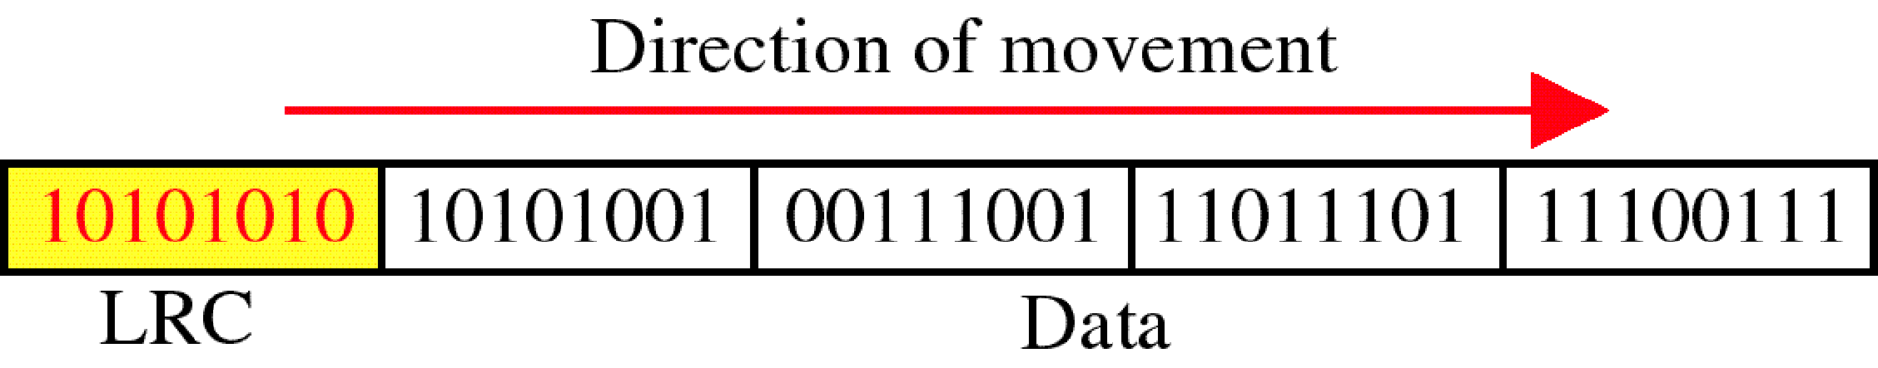
Longitudinal Redundancy Check - LRC

Slide 46
Performance
LCR increases the likelihood of detecting burst errors.
If two bits in one data units are damaged and two bits in exactly the same positions in another data unit are also damaged, the LRC checker will not detect an error.

Slide 47
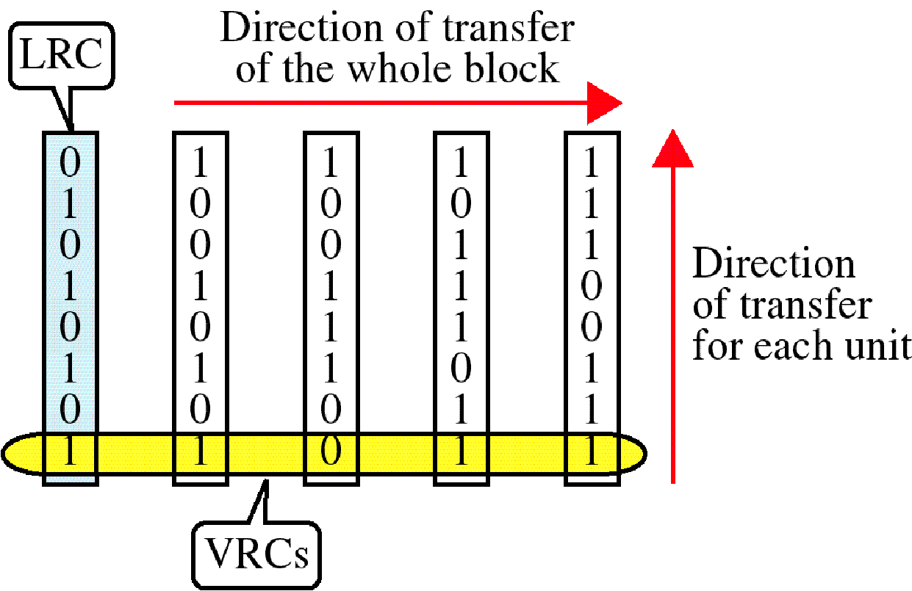
VRC and LRC

Slide 48
Cyclic Redundancy Check (CRC)
The most powerful redundancy checking technique is CRC
This method uses binary division unlike LRC and VRC which uses binary addition.
In CRC instead of adding bits together to achieve a desired parity, Sequence of redundant bits called CRC or CRC remainder is appended to the end of data unit so the resultant data unit becomes exactly divisible by second predetermined number which is the divisor.
At receiver, incoming data unit is divided by the same divisor
If there is no remainder, data unit is assumed to be intact and accepted.
If there is a remainder it means data is been damaged in transit and must be rejected.

Slide 49
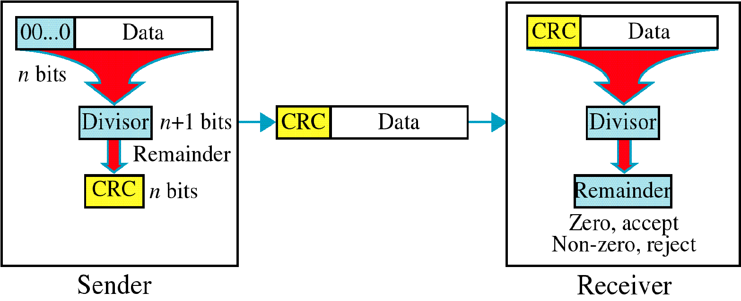
CRC

Slide 50
CRC Algorithm
First a string of 0’s appended to data unit. The number n is less than the number of bits in the divisor which is n+1
Secondly new elongated data is divided by the divisor using a process of modulo 2 binary division
Remainder resulting from division is CRC
CRC of n bits derived which is the remainder is appended to the data unit by replacing the appended 0’s
This data unit arrives at the receiver followed by CRC
Now the receiver divides the data unit by the same divisor to find the remainder
If remainder is 0 it means data is error free and is accepted
If remainder is non zero, data got error and is rejected.

Slide 51
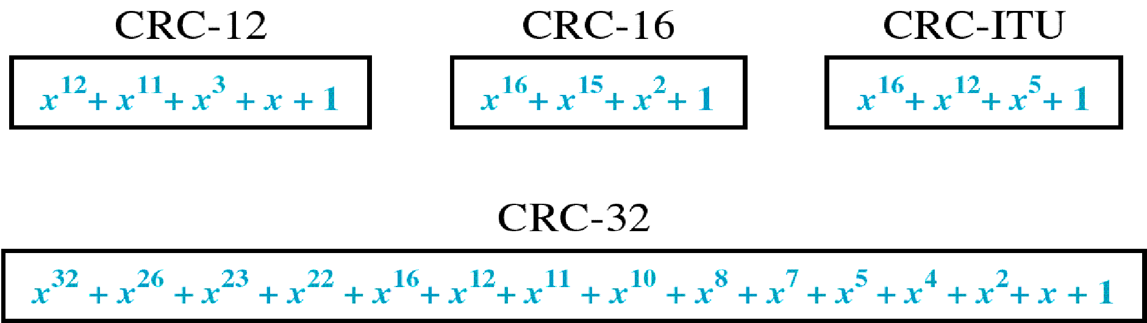
CRC Generator
CRC generator i.e. divisor is often represented as a string of 1s and 0s but as algebraic polynomial
Polynomial is represented as x⁷+ x⁶+ x⁴ +x³ +x +1
Relationship of polynomial to corresponding binary representation is 11011011
Standard CRC polynomials are CRC-12, CRC-16, CRC-ITU-T and CRC-32

Slide 52
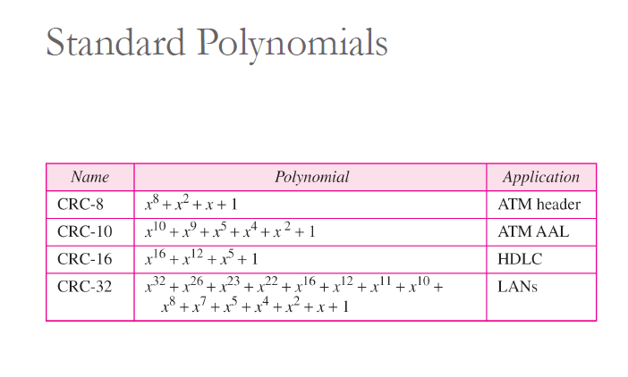

Slide 53
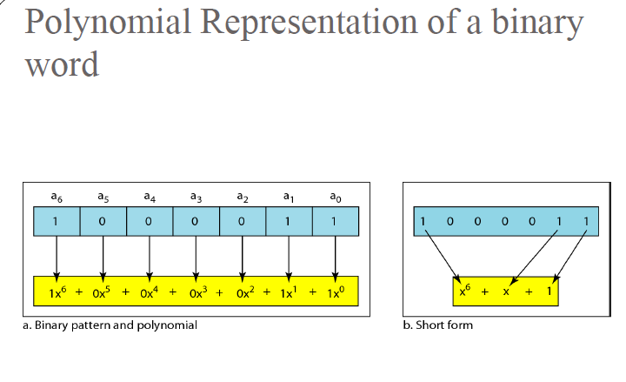

Slide 54
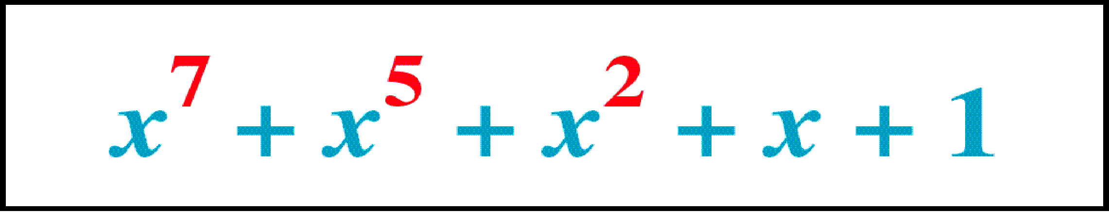
Polynomial

Slide 55
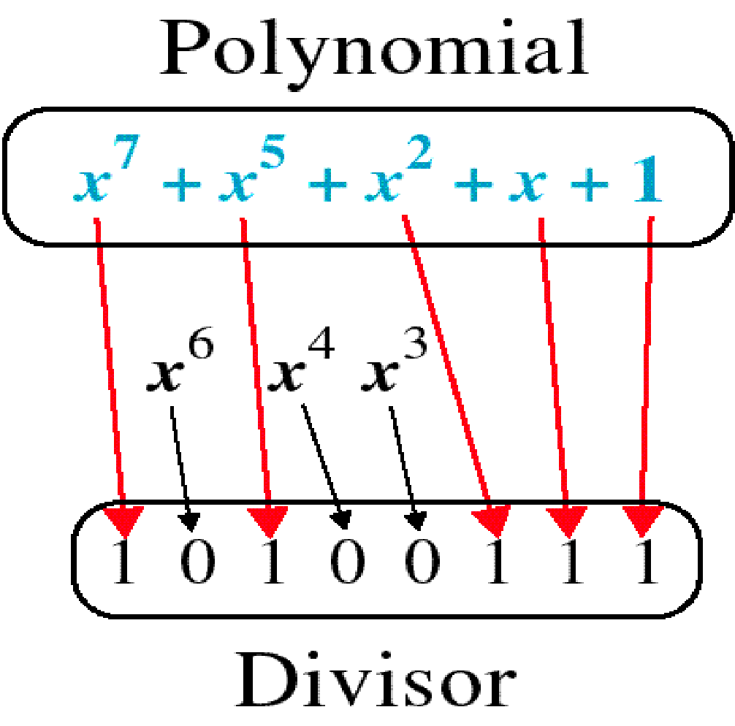
Polynomial and Divisor

Slide 56
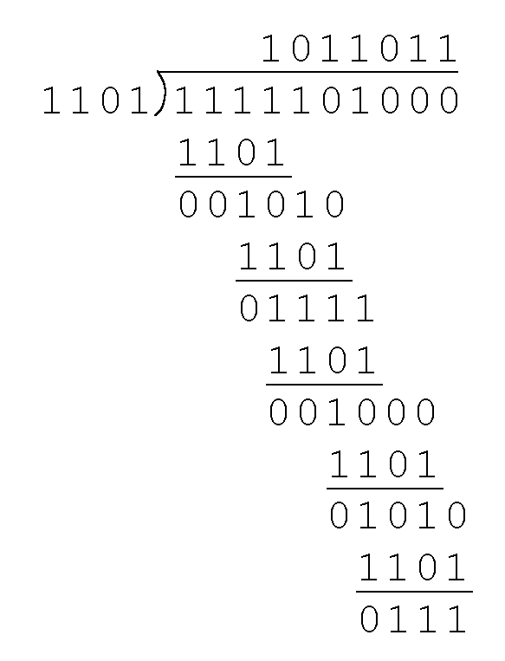
CRC Example
Example: Suppose sender want to transmit the information string: 1111101. The receiver and sender decide to use the (arbitrary) polynomial pattern, 1101 which is the divisor

Slide 57
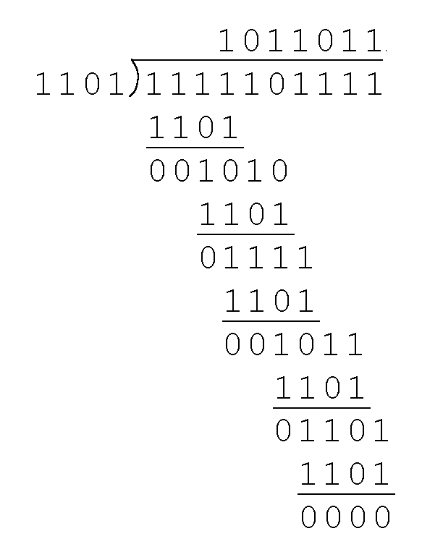
CRC
Remainder is 0111 through modulo 2 division which is added to the data unit by replacing the appended 0’s to get 1111101000+ 0111= 1111101111
Receiver divides the appended data unit by the divisor to see if remainder is zero. If zero it is error free

Slide 58
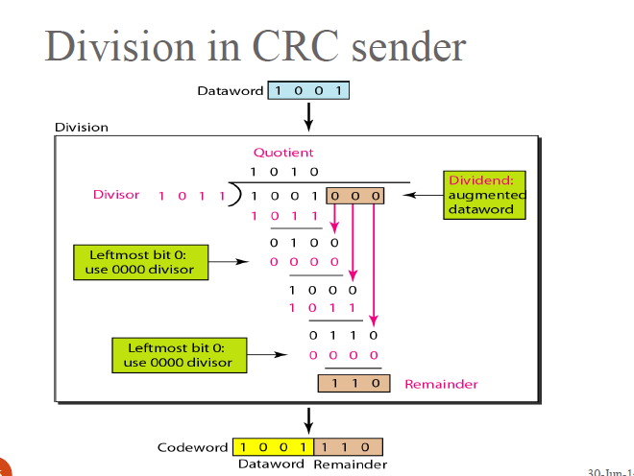

Slide 59
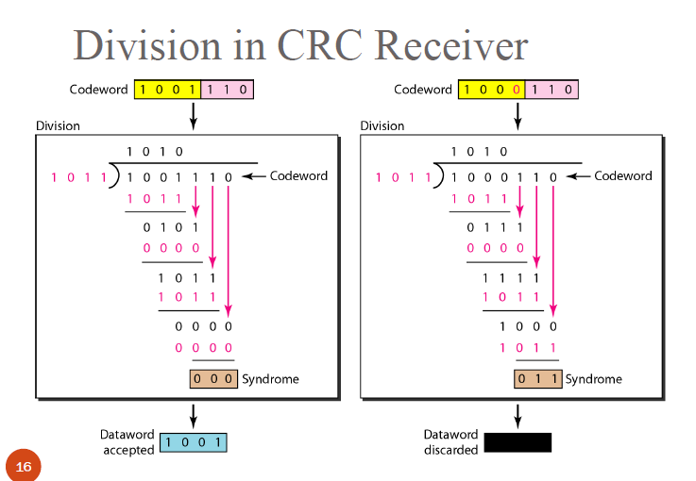

Slide 60
Checksum
Error detection used by higher layer protocols is Checksum
Checksum also is based on the concept of redundancy
Check sum Generator :
In sender, checksum generator subdivides the data unit into equal segments of n bits usually 16
These segments are added together using one’s complement arithmetic so that total is also n bits long
The total is then complemented and appended to the end of the original data unit as redundancy bits called checksum bits

Slide 61
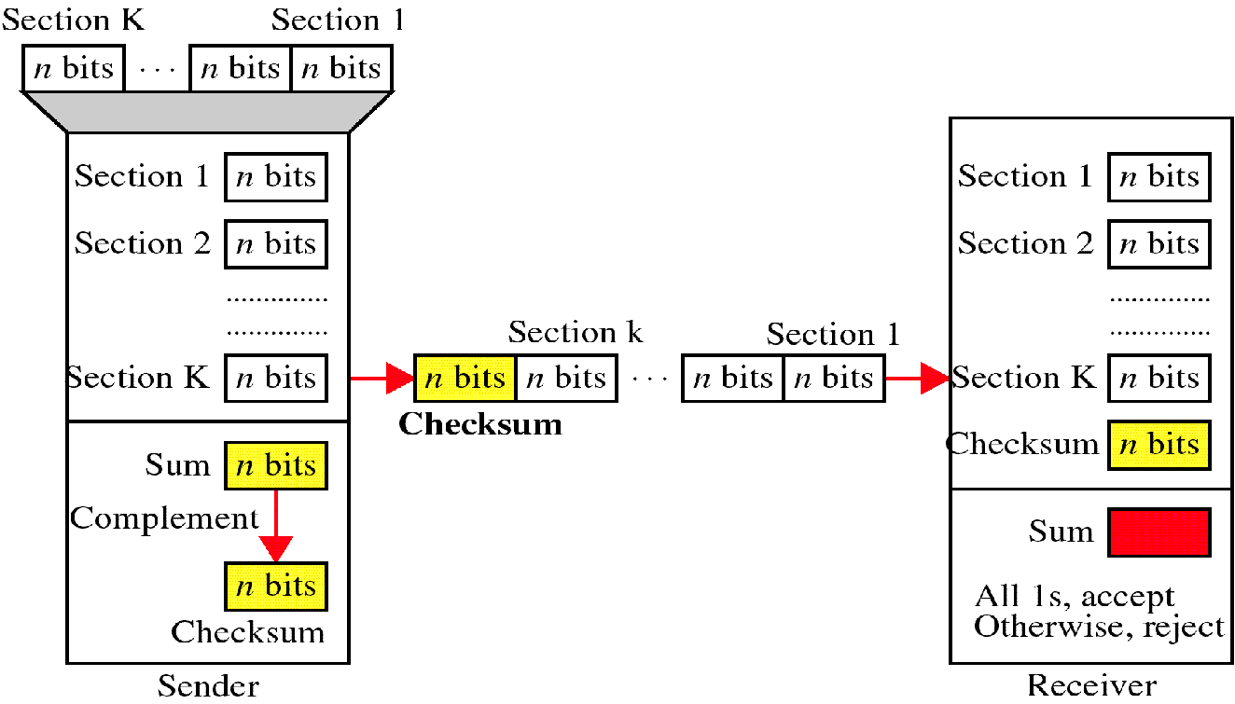
Checksum

Slide 62
At the sender
The unit is divided into k sections, each of n bits.
All sections are added together using one’s complement to get the sum.
The sum is complemented and becomes the checksum.
The checksum is sent with the data

Slide 63
At the Receiver
The unit is divided into k sections, each of n bits.
All sections are added together using one’s complement to get the sum.
The sum is complemented.
If the result is zero, the data are accepted: otherwise, they are rejected.

Slide 64
Performance
The checksum detects all errors involving an odd number of bits.
It detects most errors involving an even number of bits.
If one or more bits of a segment are damaged and the corresponding bit or bits of opposite value in a second segment are also damaged, the sums of those columns will not change and the receiver will not detect a problem.

Slide 65
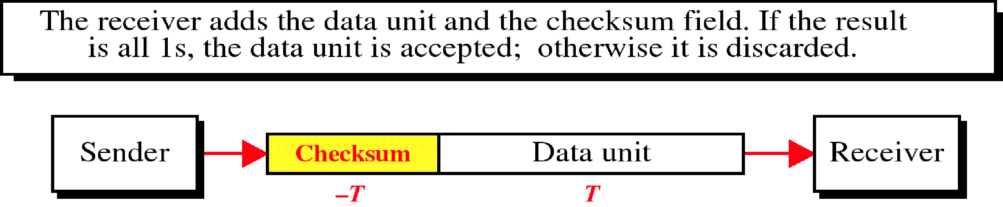
Data Unit and Checksum

Slide 66
Error Correction
Mechanisms covered till now would detect errors but not correct them
One method is when an error is detected by the receiver, the receiver can have the sender retransmit the entire data unit
Another technique is to have error correcting codes by the receiver.
These Error correcting codes are efficient to correct single bit error only
Not efficient in correcting a burst errors.
Based on this we will now see one of the famous Error correcting code- Hamming Code

Slide 67
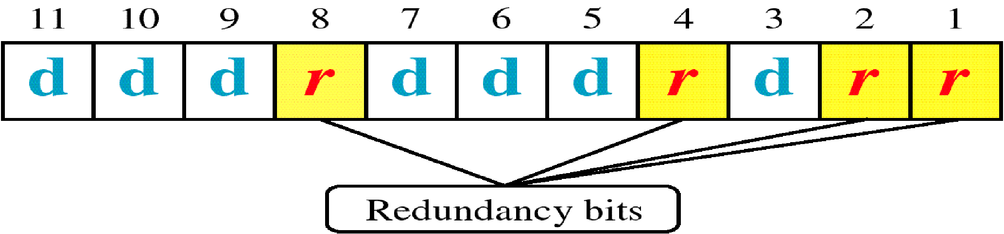
Hamming Code

Slide 68
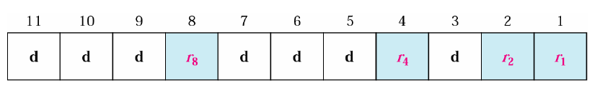
Error Correction

Slide 69
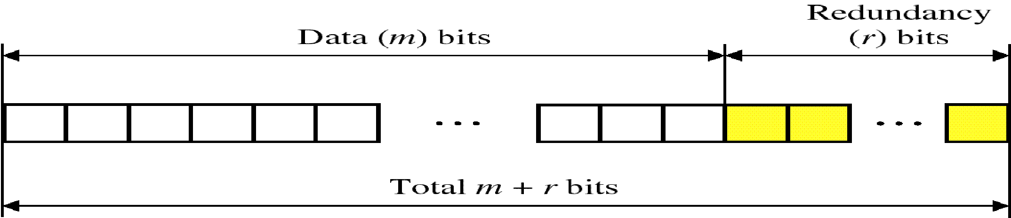
Hamming Code
Technique developed by R.W. Hamming
Applied to data units of any length and uses the relation ship between data and redundancy as 2^{r}>= m+r+1 where m is the data unit, r redundancy bit.
For example a 7 bit data would need 2⁴>= 7+4+1
Redundancy bits are placed in positions which are powers of 2
Position of redundancy bits in hamming code for m +r bits i.e 7+4= 11 bit data

Slide 70
Example: Let us say data is 7 bit word which is 1001101
We would now apply hamming code technique to see which bit got error.
Steps are:
Determine the number of redundancy/ check bits which is given as 2⁴>= 7+4+1. so we used four parity bits
Number the n bits left to right
1 0 0 r₈ 1 1 0 r₄ 1 r₂ r₁
We got to now calculate the combination of the four r values for a seven bit data sequence
For that we first write all bit positions as sums of those numbers that are powers of 2
1=1, 2=2, 3= 1+2, 4=4, 5= 1+4, 6= 2+4, 7= 1+2+4, 8=8, 9= 1+8, 10= 2+8, 11= 1+2+8
so now r₁= 1,3, 5, 7, 9, 11; r₂= 2,3,6,7,10,11; r₄= 4,5, 6,7; r₈= 8,9,10,11

Slide 71
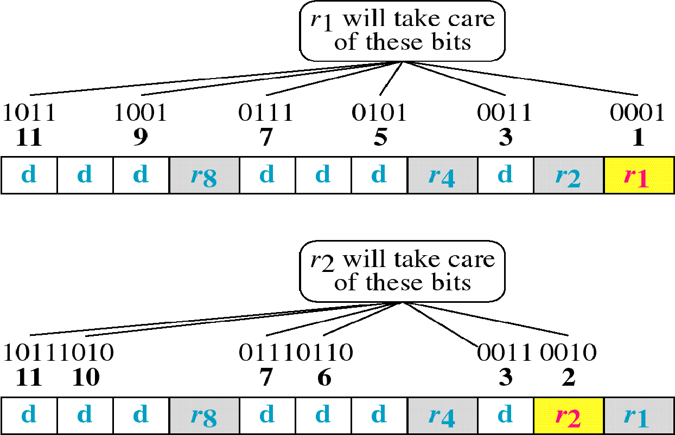

Slide 72
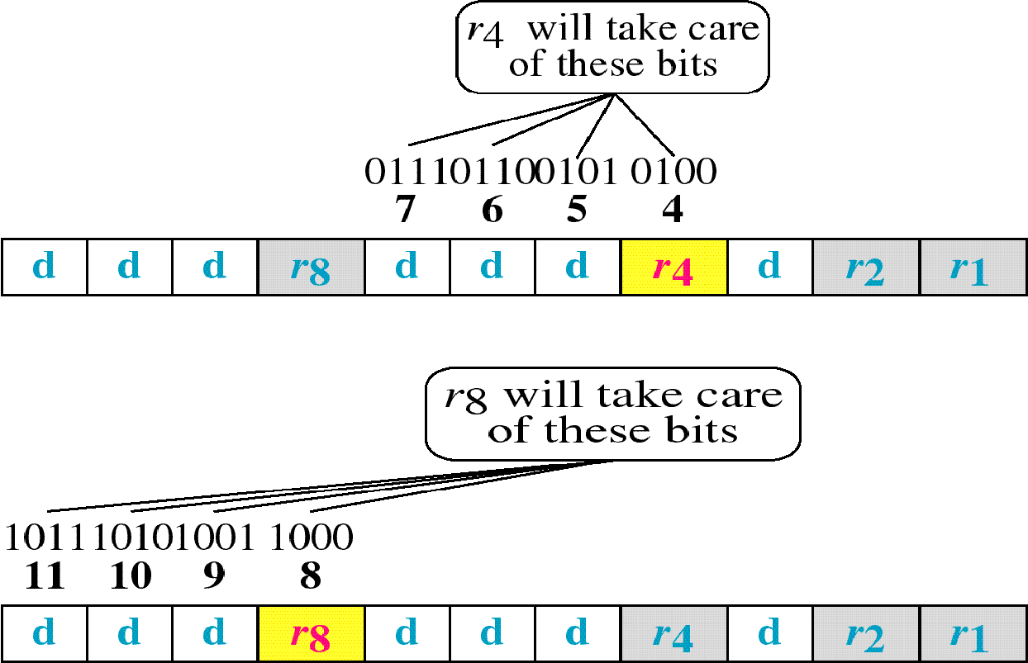

Slide 73
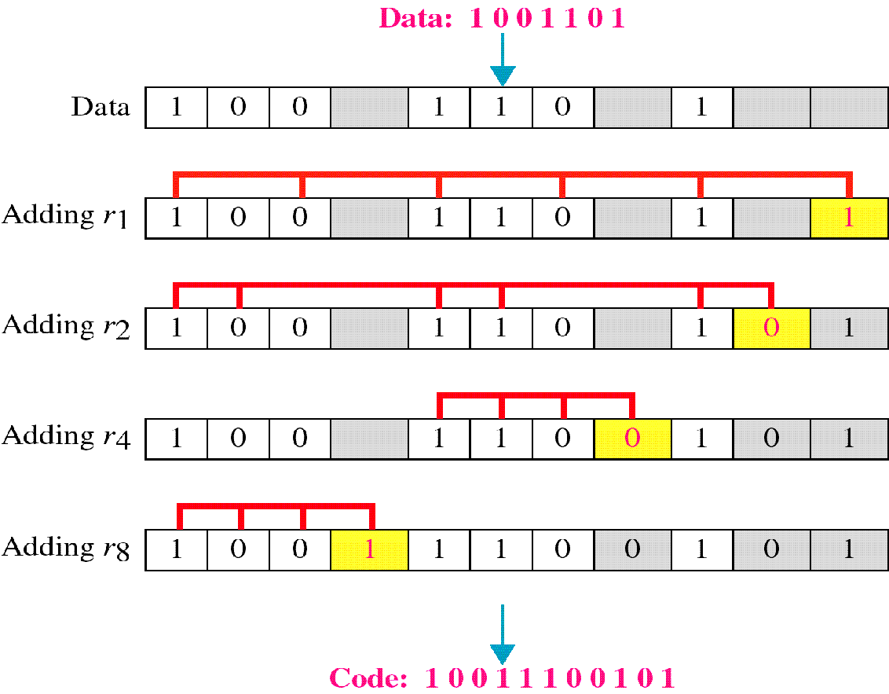
Example

Slide 74
Hamming Code
Now we write the parity bit for each of the r value . For example parity bit of r1 is calculated to provide even parity of combination 3,5,7,9,11 which sees odd number of 1’s and we add 1 to r1. Similarly we perform for r₂, r₄ and r₈ ending in the final code as 10011100101
Now the code is sent to the receiver say 10010100101and receiver calculates the four new VRC’s using the same set of bits used by sender plus relevant parity bits (r1,r2,r4, r8) for each set
Then receiver reassembles new parity values into a binary number in order of r position (r8, r4, r2, r1) which results in 0111.
That is bit 7 is the error and is corrected to give 10010100101

Slide 75
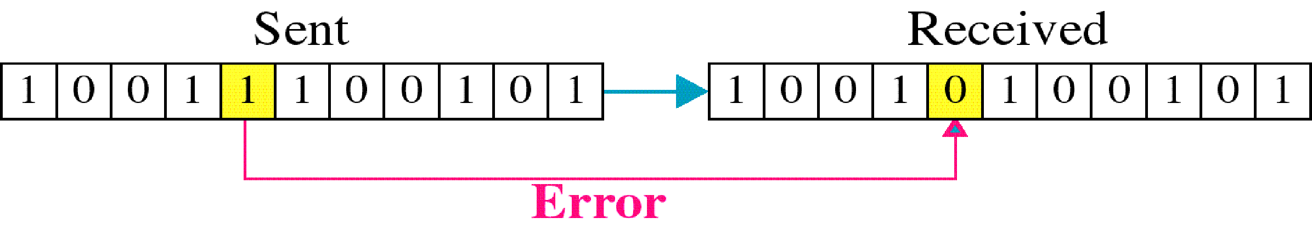
Single-bit error

Slide 76
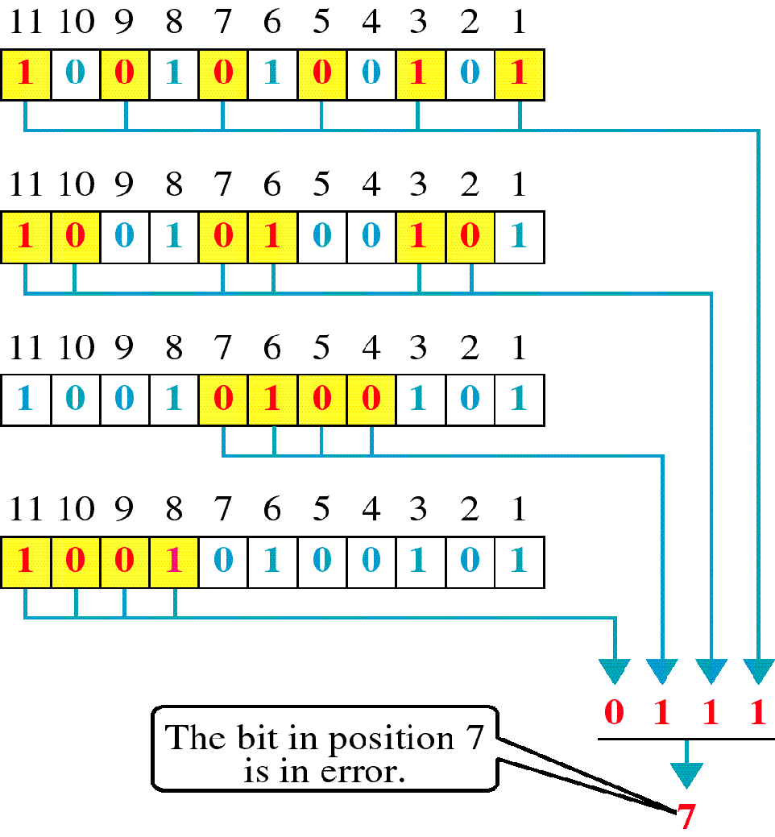
Error
Detection

Slide 77
Medium Access control Methods –CSMA, CSMA/CA & /CD

Slide 78
MULTIPLE ACCESS PROTOCOLS
When nodes or stations are connected and use a common link, called a multipoint or broadcast link, we need a multiple-access protocol to coordinate access to the link.
The problem of controlling the access to the medium is similar to the rules of speaking in an assembly.
The procedures guarantee that the right to speak is upheld and ensure that
Two people do not speak at the same time,
Do not interrupt each other,
Do not monopolize the discussion, and so on.

Slide 79
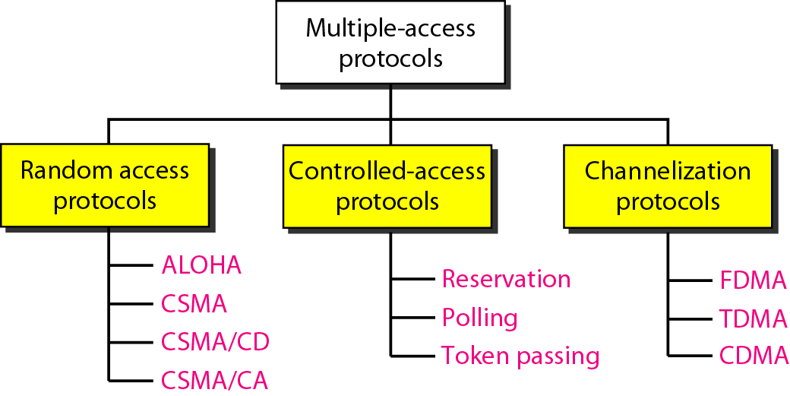
Taxonomy of multiple-access protocols discussed in this chapter

Slide 80
Random Access Methods
In random access or contention methods, no station is superior to another station and none is assigned the control over another.
No station permits, or does not permit, another station to send.
At each instance, a station that has data to send uses a procedure defined by the protocol to make a decision on whether or not to send.
This procedure depends on the state of the medium whether it is idle or busy.

Slide 81
Reason for Random Access or Contention
Two features give this methods its name
No scheduled time for a station to transmit and Transmission is random among the stations. So these methods are called random access.
No specific rules as which station should send next . Stations compete with one another to access the medium. So called Contention methods

Slide 82
Procedure followed by Station for Random Access
Each station has the right to the medium without being controlled by another station
If more than one station tries to send, there is an access conflict- collision and frames will be either destroyed or modified
To avoid access conflict or to resolve it when it happens, each station follows a procedure which answers the following queries:
When can station access the medium
What can station do if medium is busy
How can the station determine the success or failure of the transmission
What can station do if there is an access conflict

Slide 83
Random access methods we would be studying have evolved from a very interesting protocol known as ALOHA which uses a very simple procedure called Multiple Access (MA)
Method was later improved with the addition of procedure that forces the station to sense the medium before transmitting. This was called Carrier Sense Multiple Access
This later evolved into two parallel methods
Carrier Sense Multiple Access (CSMA)
Carrier Sense Multiple Access with Collision Detection and Avoidance (CSMA/CD) & (CSMA/CA)
83

Slide 84
CSMA protocol
To minimize the chance of collisions and increase the performance, the CSMA (Carrier Sense Multiple Access) method was developed
CSMA requires that each station first listen to the medium before sending
CSMA can reduce the possibility of collision but cannot eliminate it.
Possibility of collisions still exists due to propagation delay
Two CSMA protocols developed were: Persistent and non-persistent

Slide 85
Vulnerable time in CSMA
Vulnerable time in CSMA is the propagation time which is T_{p} i.e. time needed for a signal to propagated from one end to other.
When a station sends a frame and any other station sends a frame during this time, a collision will result.
But if the first bit of frame reaches the end of medium, every station will have heard the bit and will refrain from sending.
Figure in next slide shows the worst case where a frame sent by station A at time t₁ reaches the rightmost station D at time t₁+ T_{p}

Slide 86
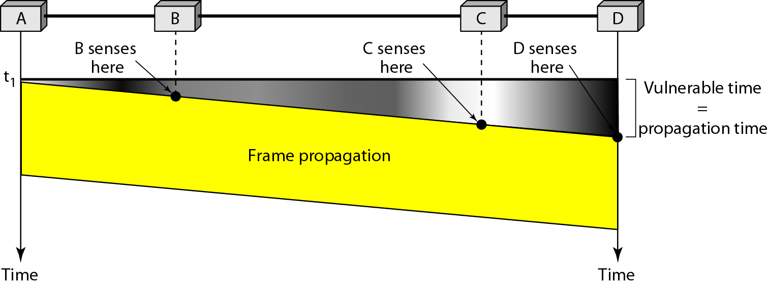
Vulnerable Time in CSMA

Slide 87
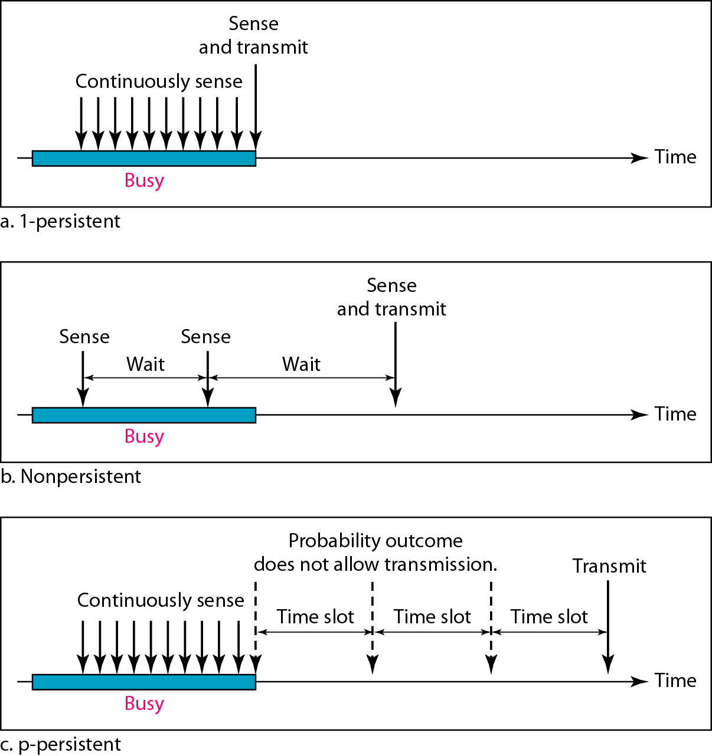
Behavior of three persistence methods

Slide 88
1-Persistent CSMA protocol
When station finds the medium is idle, it sends its frame immediately with a probability of 1.
If the medium is busy it waits until it becomes idle and sends its frame with a probability of 1.
Method has highest chance of collisions because two or more stations may find the line idle and send their frames immediately.

Slide 89
Non-persistent CSMA protocol
Station senses a channel
If channel is idle, station begins transmitting
If channel is busy, station does not continually wait for accessing the channel
Instead it waits a random period of time and then repeats algorithm again- Exponential Back off
This method reduces the collision as it is unlikely two or more stations will wait the same amount of time and retry to send simultaneously

Slide 90
p-persistent CSMA protocol
This method is used if channel has time slots with slot duration equal to or greater than maximum propagation time
p-persistence approach combines the advantages of other two methods.
Reduces the chances of collision and improves efficiency
Here once the station finds the line is idle, it follows these steps:
i With probability p, station sends its frame
ii With probability q= 1-p, station waits for beginning of the next time slot and checks the line again
a. If line is idle, it goes to step i
b. If line is busy, it acts as collision has occurred and uses back off procedure.

Slide 91
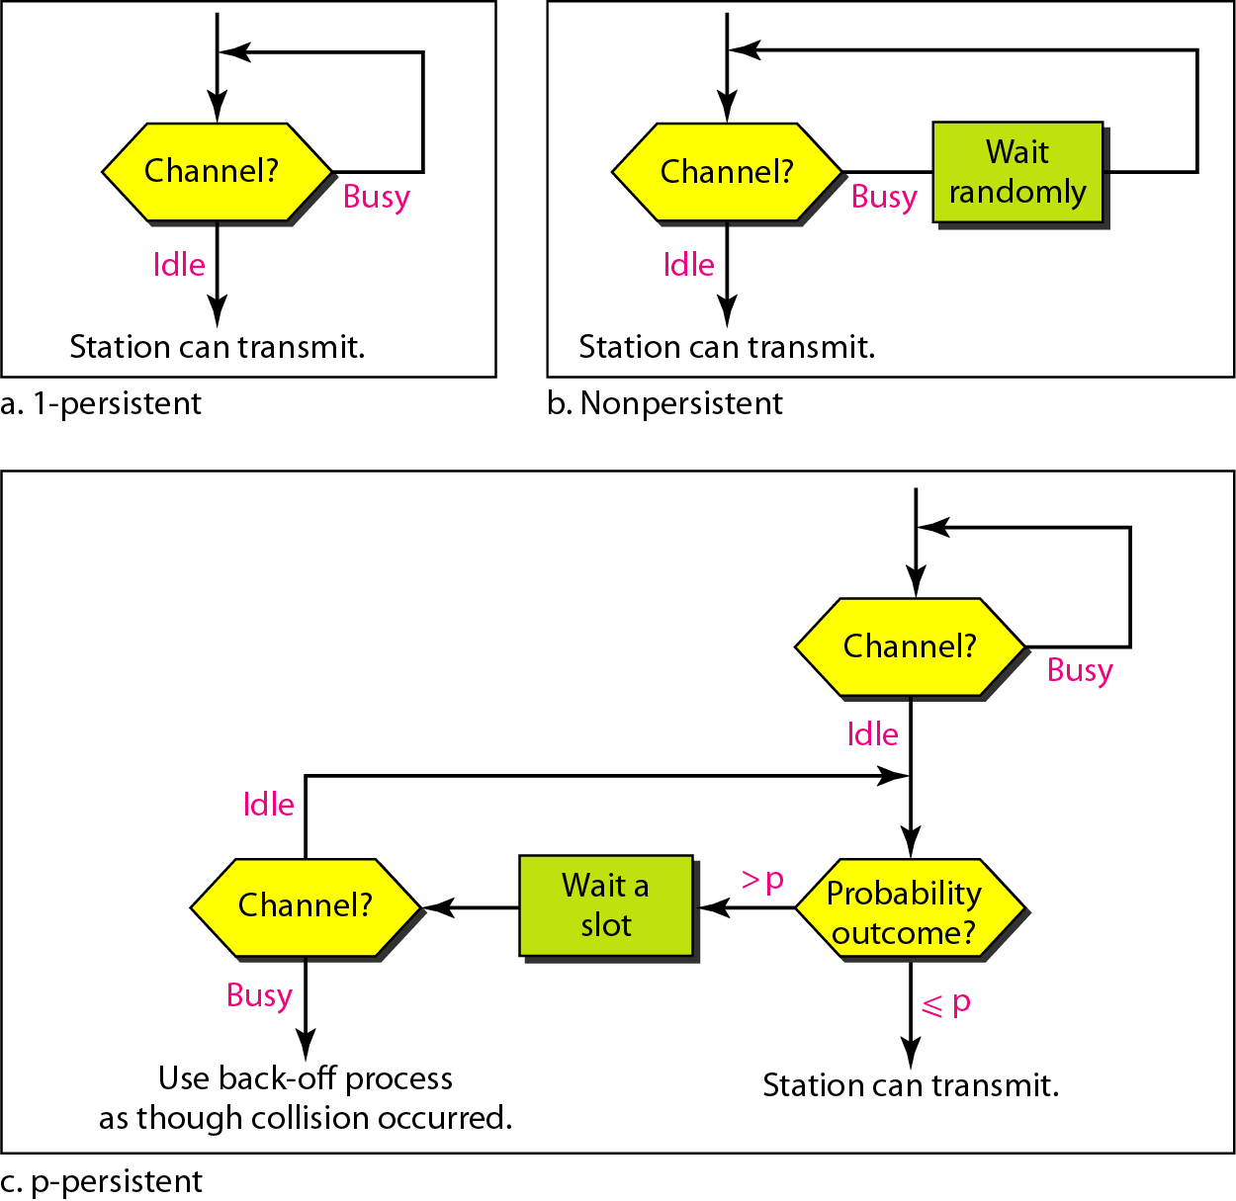
Flow Diagram of three persistence methods

Slide 92
Carrier Sense Multiple Access with Collision Detection (CSMA/CD)
CSMA method does not specify the procedure following a collision
CSMA/CD augments the algorithm to handle collision
In this method, a station monitors the medium after it sends a frame to see if the transmission was successful
If successful, the station is finished
If not, frame is sent again.
We can better understand CSMA/CD with the diagram in next slide.

Slide 93

Collision of first bit in CSMA/CD

Slide 94
At time t1, Station A has executed the persistence procedure and starts sending the bits of its frame
At time t2 station C has not yet sensed the first bit sent by A .
Station C executes its persistence procedure and starts sending bits in frame which propagates to both left and right
Collision occurs after time t2.
Station C detects a collision at time t3
when it receives first bit of A’s frame.
Station C aborts its transmission
Station A detects collision at time t4 when it receives first bit of C’s frame; it also aborts its transmission immediately.
We see that A transmits for a duration of t₄-t_{1;} C transmits for duration of t₃-t_{2.}
At time t₄ transmission of A’s frame though incomplete is aborted; time t₃ transmission of C’s frame though incomplete is aborted

Slide 95

Collision and abortion in CSMA/CD

Slide 96
Minimum Frame size for CSMA/CD
For CSMA/CD we need restriction of the frame size
Before sending the last bit of frame, sending station must detect collision , if any must abort the transmission
Reason for this is a station once sent the entire frame does not monitor the line for collision detection
So, Frame Transmission time T_{fr} = 2 * T_{p}
If two stations involved in collision are maximum distance apart, signals from first takes time T_{p} to reach the second and effect of collision takes another time T_{p} to reach the first.
Requirement is first station should still be transmitting after 2 T_{p}

Slide 97

Flow Diagram for CSMA/CD

Slide 98
Example
A network using CSMA/CD has a bandwidth of 10 Mbps. If the maximum propagation time (including the delays in the devices and ignoring the time needed to send a jamming signal, as we see later) is 25.6 μs, what is the minimum size of the frame?
Solution
The frame transmission time is T_{fr} = 2 × T_{p} = 51.2 μs. This means, in the worst case, a station needs to transmit for a period of 51.2 μs to detect the collision. The minimum size of the frame is 10 Mbps × 51.2 μs = 512 bits or 64 bytes. This is actually the minimum size of the frame for Standard Ethernet.

